Slide 1
A progressive agenda for (UK) finance
Daniela Gabor
UWE Bristol

Slide 2
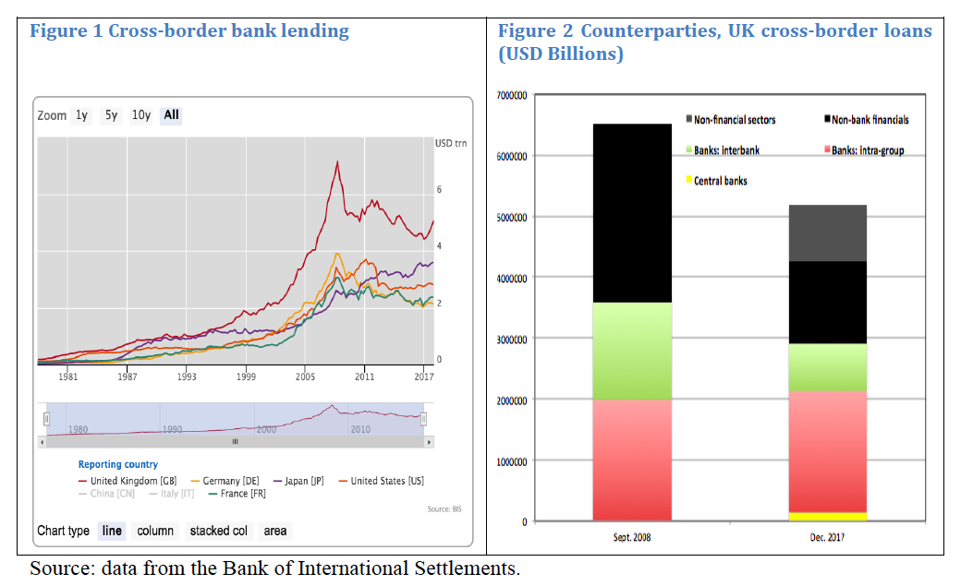
UK finance: great for finance capitalism

Slide 3
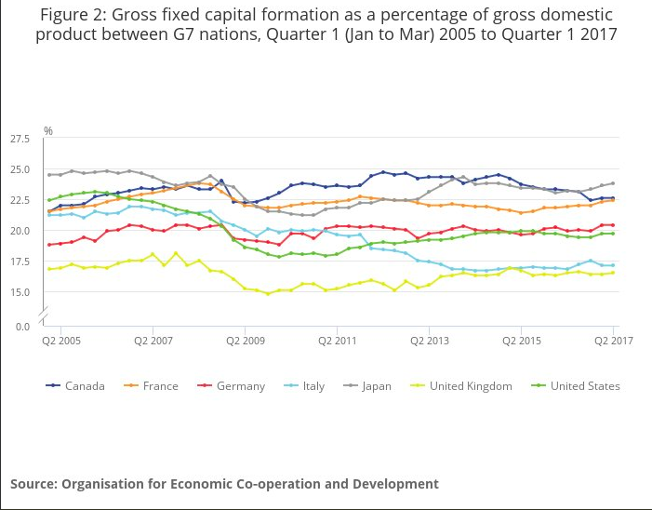
But not so good for industrial capitalism, growth, job creation

Slide 4
A progressive agenda for finance
National Investment Bank – with two progressive add-ons
Rethinking UK’s role in global financial capitalism

Slide 5
National Investment Bank
Well-established ‘arm of the state’ (Germany KfW)
Structural aims: industrial strategy
Countercyclical aims: constraints imposed on investment by austerity, banks’ credit rationing & fragilities of credit credit creation via securities markets

Slide 6
National Investment Bank
An intermediary not a bank
GBP 250billion, channeled through Regional Development Banks for on-lending, to be distributed in a sustainable, regionally-balanced and equitable way

Slide 7
Critiques
Can the state pick winners? Yes, in cooperation with private sector
Crowding out private investment? No:
additional capital investment, channeled through local banks – improving stable funding
bond financing of NIB to meet demand from institutional investors (safe asset shortage)
Notes:
Invoking the poor track record of the National Enterprise Board, as the right does, not enough to dismiss the idea - that the British state failed to pick winners in the past does not imply it could not develop careful strategies to do so in the present, drawing on the experience of the successful development banks. Also point out that the markets typically good at picking winners when subsidized by the state
It is often argued that the bond financing for NIB would hurt private investment by pushing up interest rates in securities markets – two arguments against that: (a) only large corporates tap securities markets for financing, and the QE program has subsidized their financing after the crisis; (b) it is unlikely that bond issuance would raise interest rates give the demand for safe assets from institutional investors.

Slide 8
Two progressive add-ons
Green on-lending: draw on European Commission plans for transition to sustainable finance
brown penalizing factor for bank loans & securities inconsistent with ESG framework
Harness the money-creating power of central banks (Gabor and Kalisperas 2017)
replace bond financing for NIB with public shadow money & retail financing for private banks
one-off agreement with the Bank of England, similar to Term-Funding Scheme
Notes:
The European Commission recently announced plans to engineer transition to sustainable finance, guided by the Environmental, Social and Governance principles. A progressive approach to banking&finance policy
If pressures in bond markets, or very successful experience throughout the early years of the NIB - convert it into a SDB – see more details here http://speri.dept.shef.ac.uk/2017/07/06/how-to-fund-a-state-development-bank-a-two-stage-proposal/
Note here that this scheme does not infringe on the independence of the central bank - as it is a well-defined, time-constrained scheme.

Slide 9
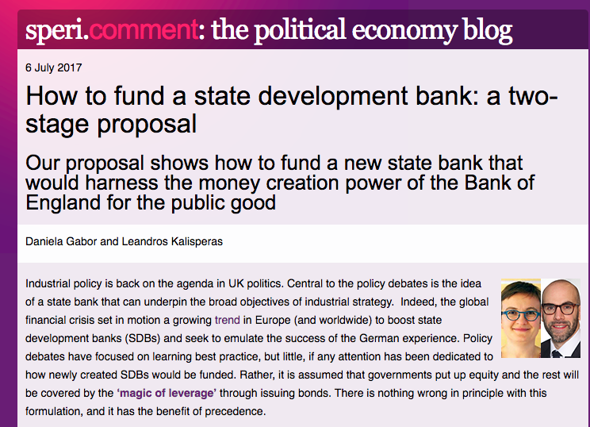

Slide 10
SDB loan to Green Energy Company (GEC)
Private bank
BoE Reserves
GEC Deposit
National Development Bank
Bank of England
Loan to GEC
NDB bonds
Loans to commercial banks
BoE Reserves
Notes:
Upgrade the NIB to State Development Bank once sufficient expertise to identify potentially viable projects.
The SDB makes its own loans, in this case to a Green Energy Company. It simultaneously creates a deposit for the GEC. GEC can only use the deposit for payments if it transfers it to a private bank (thus increasing the stable retail funding base of the private banking system).
When GEC deposit is transferred to the private bank, the SDB also has to transfer an asset, in the form of Bank of England reserves. This is how banks, public or private, pay each other.
The SDB gets reserves by borrowing from the Bank of England, using the loans it makes as collateral. This is a standard repo loan that Bank of England uses to lend to banks, with once exception – the tenor of the repo loan will match the tenor of the SDB loans used as collateral.
The Bank of England harnesses the liquidity enhancing properties of repo loans without the fragilities that triggered the collapse of Lehman Brothers – it will not mark to market. The potential losses are in no way different from those attending unconventional monetary policy measures, whereas this type of unconventional monetary policies may be more effective in triggering productivity-enhancing investments.
The financial system - in particular banks – may welcome this reserve injection from the Bank of England given that the Basel III requirements on liquidity and leverage create a structural demand for central bank reserves.

Slide 11
SDB loan to Green Energy Company (GEC)
Private bank
BoE Reserves
GEC Deposit
3
State Development Bank
1
Bank of England
Loan to GEC
GEC ‘Deposit’
Repo loan to SDB
BoE Reserves
BoE Reserves
BoE repo deposit
2
GEC loan collateral
Public shadow money
Notes:
Upgrade the NIB to State Development Bank once sufficient expertise to identify potentially viable projects.
The SDB makes its own loans, in this case to a Green Energy Company. It simultaneously creates a deposit for the GEC. GEC can only use the deposit for payments if it transfers it to a private bank (thus increasing the stable retail funding base of the private banking system).
When GEC deposit is transferred to the private bank, the SDB also has to transfer an asset, in the form of Bank of England reserves. This is how banks, public or private, pay each other.
The SDB gets reserves by borrowing from the Bank of England, using the loans it makes as collateral. This is a standard repo loan that Bank of England uses to lend to banks, with once exception – the tenor of the repo loan will match the tenor of the SDB loans used as collateral.
The Bank of England harnesses the liquidity enhancing properties of repo loans without the fragilities that triggered the collapse of Lehman Brothers – it will not mark to market. The potential losses are in no way different from those attending unconventional monetary policy measures, whereas this type of unconventional monetary policies may be more effective in triggering productivity-enhancing investments.
The financial system - in particular banks – may welcome this reserve injection from the Bank of England given that the Basel III requirements on liquidity and leverage create a structural demand for central bank reserves.

Slide 12
Progressive framework for financial capitalism
Context: global effort to promote market-based finance (Maximising Finance for Development, Sustainable Finance, shadow banking reform)
Structural drivers: replacing collective with asset-based welfare (pension funds, insurance companies) & state’s inability to tax mobile capital and high-net worth individuals
A new array of systemic actors: institutional investors, asset managers
Notes:
Note here that the Financial Stability Board and the G20 have been driving this process
Andy Haldane – the age of asset management

Slide 13
Progressive framework for market-based finance
Market-based finance more fragile than banking (10 years since Lehman)
A progressive social contract with market-based finance:
Encouraging patient capital
A (small) FTT to contain leverage & pro-cyclical liquidity creation and destruction
Notes:
\

